Slide 1
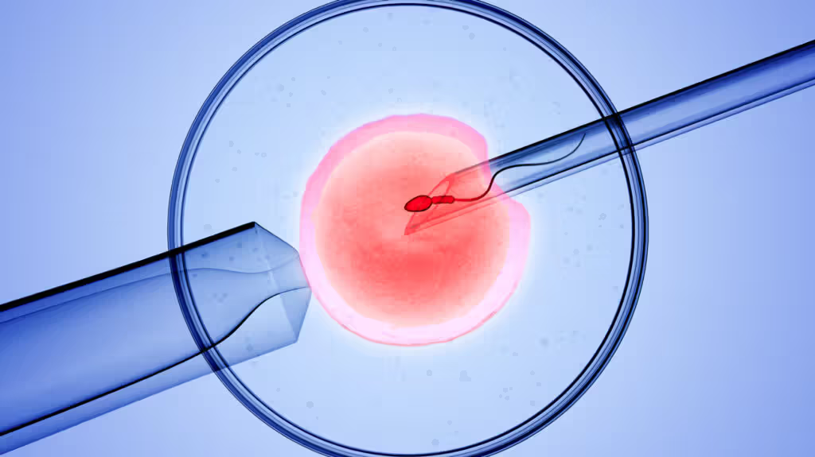
Ovarian stimulation Protocols in ART
Prof Shamila Ijaz Munir
MRCOG(UK), FRCOG(UK), FACOG(USA), MHPE (UHS)
Fellowship in Rep Med and ART (Germany)
Diploma in Urogynae (Germany)

Slide 2

Objectives
To know the selection criteria of women for IVF
To know different tests required for IVF
To know different protocols of ovarian stimulation, advantages and disadvantages
To known about Trigger & Luteal phase support
Way forward

Slide 3
Aim of Ovarian Stimulation Protocol
Multifollicular development with gonadotrophin administration is the main stay of the ovarian stimulation.
Secondly, all protocols work towards inhibition of premature LH surge as it causes poor egg quality, premature ovulation and disrupt the endometrium significantly reducing the chances of successful implantation and pregnancy
IVF protocols are different hormone regimens, which are selected for each woman individually.

Slide 4

Ovarian Stimulation Protocols
Suppression Protocol/ long protocol
Flare Protocol/ short protocol
Antagonist protocol

Slide 5
Injections of ART
Gonadotrophin
HMG…………… inj Menogon IM (75 FSH, 75LH)
FSH…………….. Inj Follitrope IM (75 FSH, <0.1 LH)
  GnRHa………… Inj decapeptyl S/C 0.1 mg
  GnRHant………… Inj cetrotide IM 0.25 mg
  HCG ……. Inj IVF C 10,000 IU

Slide 6
Ovulation induction – individualized
Patient Age
Type of infertility, cause, duration,
PCO / non PCO
Past IVF protocol
BMI
Ovarian reserve tests

Slide 7
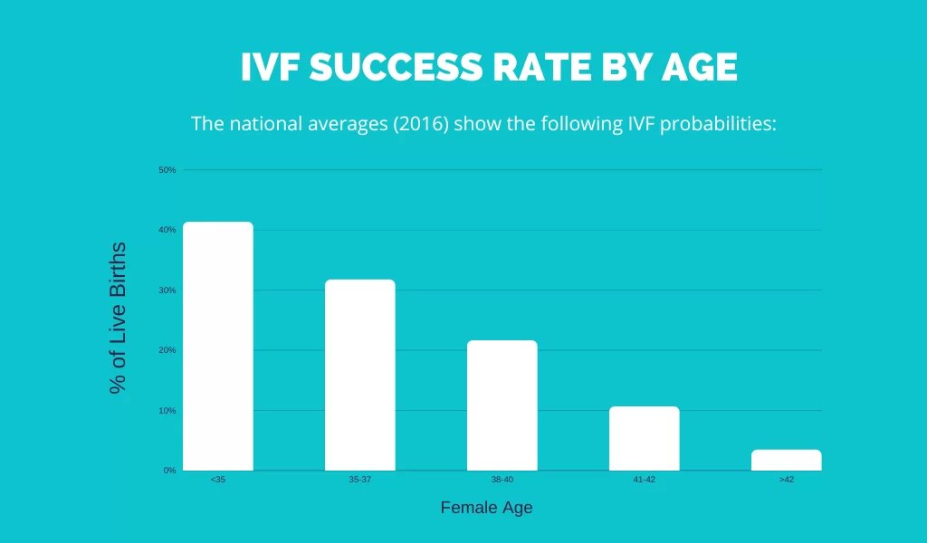

Slide 8
Ovarian reserve tests
FSH, AMH, Inhibin
Single nucleotide polymorphism for FSH R, LH R, AMH R
Antral Follicular count AFC
Hormonal
Biomarkers
Functional
Biomarkers
Genetic
Biomarkers

Slide 9
Ovarian reserve testing before the first IVF cycle categorize patients (NICE, 2013)
 | Low response | High response
Total AFC | 4 or less | 16 or more
AMH Ng/ml | 0.8 or less | 3.5 or more
FSH IU/L on D2 | 8.9 or more | 4 or less

Slide 10
FSH starting dose (IU/day)
<37 yr old: 150
37-39 yr: 225
>40 yr: 300
BMI>30 Kg/m :increase by 75
Adjust dose as cycle monitoring proceeds with U/S & E2 but
Do not use a dose of FSH>450 IU/d

Slide 11
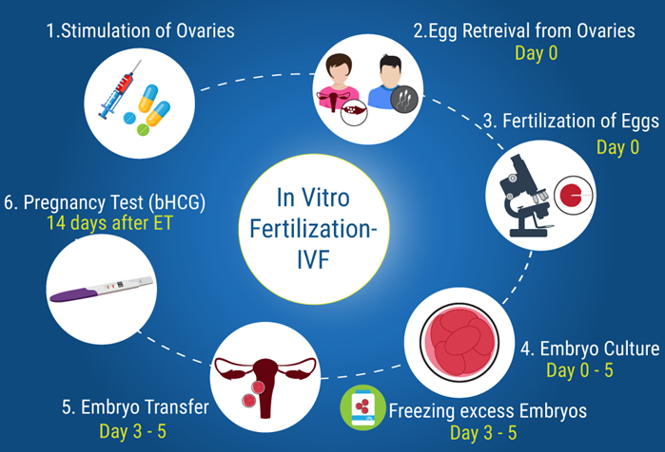
Ovarian stimulation and monitoring

Slide 12
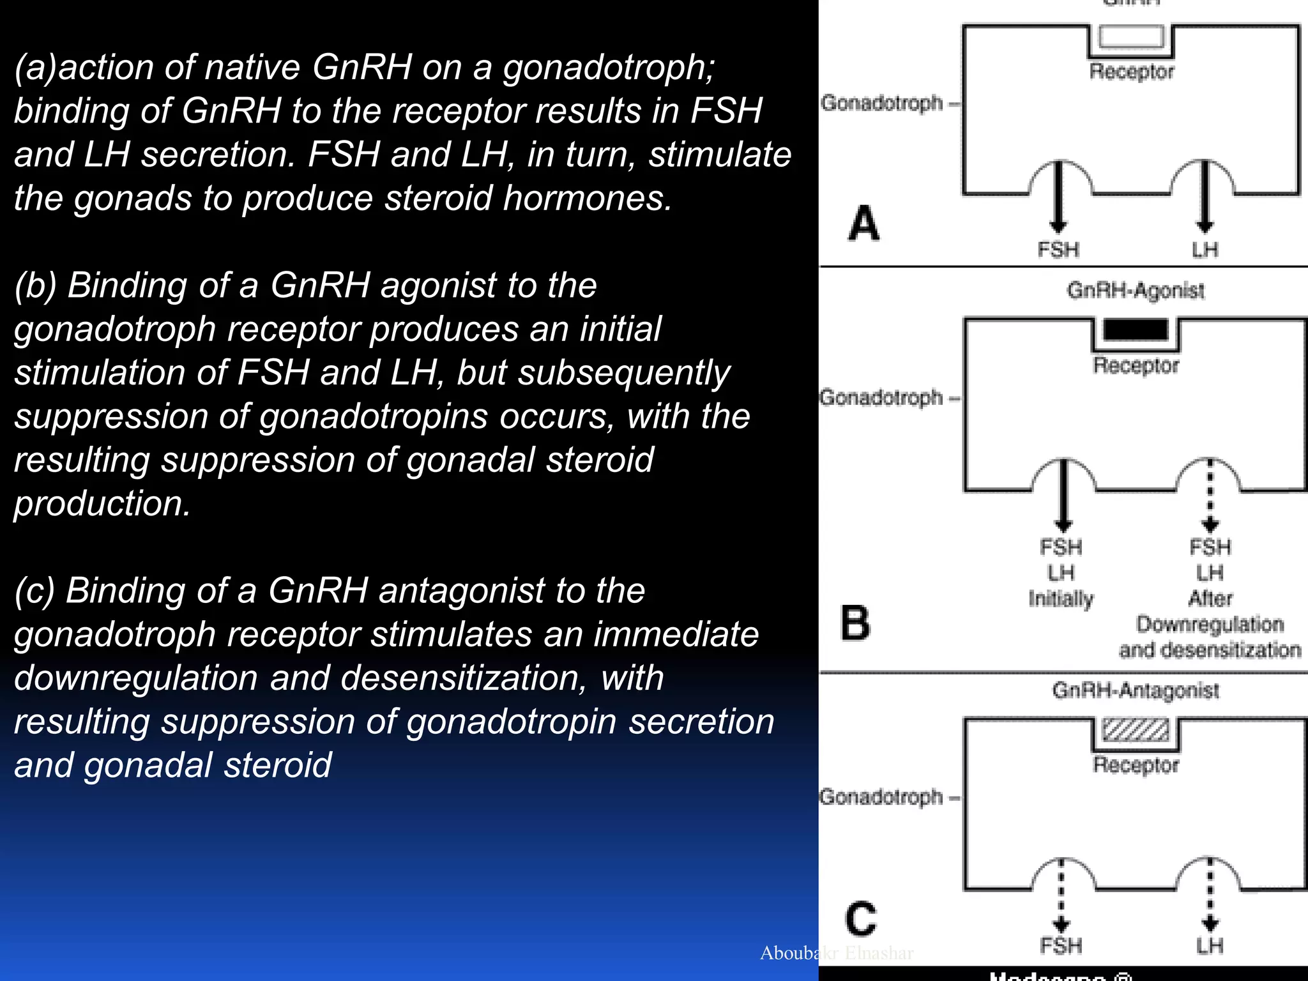
(a)action of native GnRH on a gonadotroph; binding of GnRH to the receptor results in FSH and LH secretion. FSH and LH, in turn, stimulate the gonads to produce steroid hormones.
(b) Binding of a GnRH agonist to the gonadotroph receptor produces an initial stimulation of FSH and LH, but subsequently suppression of gonadotropins occurs, with the resulting suppression of gonadal steroid production.
(c) Binding of a GnRH antagonist to the gonadotroph receptor stimulates an immediate downregulation and desensitization, with resulting suppression of gonadotropin secretion and gonadal steroid

Slide 13
Effects of GnRha
Flare effect: Within 12 h and lasting 24-48 h
Continuous administration: opposite effects
internalization of the agonist /receptor complex & decrease in
the number of receptors(down-regulation). This will allow prevention of premature LH surge, until full oocyte maturity can be reached.
The main advantage of the method is the ability to fully control the development of follicles. With the help of ovulation induction, a large number of high-quality eggs are obtained, which increases the likelihood of pregnancy.

Slide 14
Long protocol / Suppression protocol
GnRH-a is given from D21 of the cycle. Down regulation of the pituitary gland is achieved as confirmed suppression tests.
Suppression check done of D2 of periods
Criteria of suppression:
  Hormonal assay: E2 <50 pg/ml, Progesterone <1 ng/ml, LH <5 IU,
  TVS: No follicle greater than 5 mm and no ovarian cysts
  Endometrial thickness <6 mm
Predicts down regulation in 95% of cases

Slide 15
Long GnRHa Protocol (luteal phase)
TVS
E2
TVS > 18 ml
E2 >3000
TVS
E2
<50 pg/ml
75-300 IU / FSH
35 hr
Luteal Support
GnRHa 0.1mg/day
2 weeks
OPU
20th day
previous
cycle
FSH
hCG
5-10000 IU

Slide 16
Short protocol / Flare up protocol
GnRH-a is started on day one or two of the cycle.
Exogenous FSH administration is started on day 2 of the cycle to continue follicular stimulation, meanwhile complete pituitary desensitization occur.
Main disadvantage – less chances of success, due to the small number of produced eggs and their uneven growth. A short protocol can be assigned to a patient with enough ovarian reserve at any age.

Slide 17
Short GnRHa Protocol
TVS
E2
TVS > 18 ml
E2 >3000
FSH 75-300 IU
35 h.
Luteal Support
GnRHa 0.1mg/day
4 DAY
OPU
Trigger
10.000 IU
hCG
Cycle
Day2

Slide 18
Advantages:
long protocol Vs Short (Cochrane review, 2020)
Long protocol is superior in terms of
follicular development &
fertilization rate
number of embryos suitable for transfer
Pregnancy Rate
Short protocol is good for low ovarian reserve women
Is economical as less gonadotrophin used

Slide 19
GnRHant PROTOCOLS
HMG or FSH started from day 2 of the cycle
Cetrorelix or Ganirelix: 0.25 mg daily SC from stimulation day 5 or 6 (fixed protocol) or leading follicle14 mm (Flexible protocol) onwards until the day of trigger
Advantages:
Prevents premature LH surge
Effective in terms of CPR (22%).
Safe in terms of a low incidence of patients hospitalized due to OHSS.

Slide 20
Treatment protocol with the GnRH antagonist
Leading
follicle reach
14 mm
Leading follicles >18mm
Trigger GnRh agonist 0.3mg
or
Day 6
of FSH
Day 2
of Menses
FSH 225/ 300 IU
Cetrotide 0.25mg SC

Slide 21
Agonists Vs Antagonists
• Antagonist protocol:
short, simple with significant decrease in severe OHSS & amount of Gonadotrophins.
CPR and OPR is lower in antagonist group
No evidence of a difference in LBR

Slide 22
TRIGGERING OF OVULATION
Ovulation follow IM injection of HCG as HCG causes LH surge and final maturation of follicles.
Usual dose in GnRH agonist cycles:
10,000 IU administered 34-36 h before the scheduled time of oocyte retrieval.
When:
At least 3 follicles >18 mm
E2: 150 pg/ml per >15mm follicles.
Endometrium: Thickness >8mm, Triple line

Slide 23
Risk: OHSS
long half life (30 H) with serum hCG detectable up
to 14 days after the injection.
prolonged luteotrophic effect
Vascular endothelial growth factor (VEGF) is secreted by the granulosa cells, and it plays a critical role in the pathogenesis of OHSS by increasing vascular permeability.
(development of OHSS via the enhancement of
capillary leak)

Slide 24
Inj GnRHa is used in antagonist cycles for trigger
Flare effect of GnRHa causes pituitary endogenous LH surge which is enough to cause a trigger but does not last enough to result in OHSS.
Disadvantage is that Fresh Embryo Transfer cannot take place due to impaired endometrium receptivity and no HCG support to sustain corpus luteum
Freeze All strategy

Slide 25
Dual Trigger
To allow for a fresh transfer with improved pregnancy rates and reduced risk of OHSS, the combined use of both hCG in a lower dose and a GnRH agonist, called ‘‘dual trigger’’, has been used to trigger final oocyte maturation.
This combination has the advantage of minimizing the OHSS risk,
because the GnRH agonist serves as the main ovulation
trigger with a shorter half-life than that of hCG, whereas
the inclusion of a low dose of hCG provides additional luteal
support.

Slide 26
Cycle cancellation
The main reasons
1 .No or poor egg production (83%)
2. Patient's personal reasons (10%)
3.Excessive response to ovarian stimulation and risk of developing OHSS (5%)
4.Medical illness (1 %).

Slide 27
Luteal Phase Support
Micronised Progesterone tablets
• Oral: 100-200 mg 2-4X/day
• Vaginal: 100-200 mg 2X/day
• Rectal: 100-200 mg 2X/day
Progesterone Suppository
200-400 mg vag. or rectally 1-2X/day
IM Progesterone 100 mg 1x/day
Progesterone gel (8%)

Slide 28
What is success in IVF treatment
• Live birth
•Reduce cancellation due to poor response
• Reduce cancellation and hospitalization due to OHSS
• Reduce multiple pregnancies
• Minimize stimulation burden
• Achieve high chance of pregnancy

Slide 29
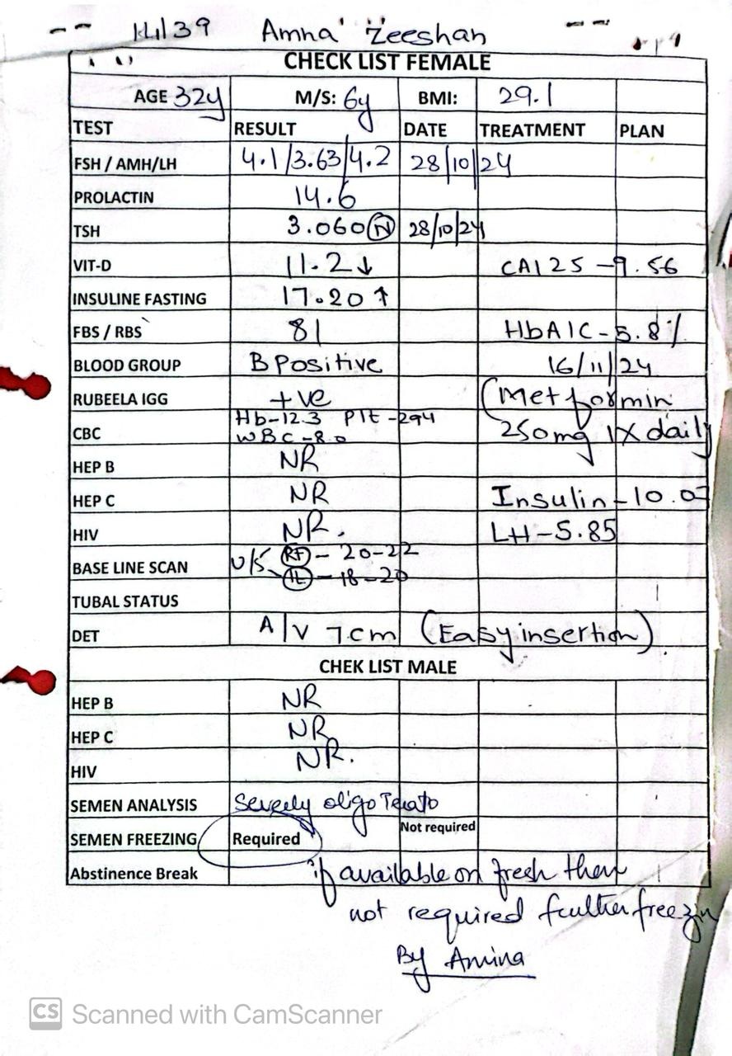

Slide 30
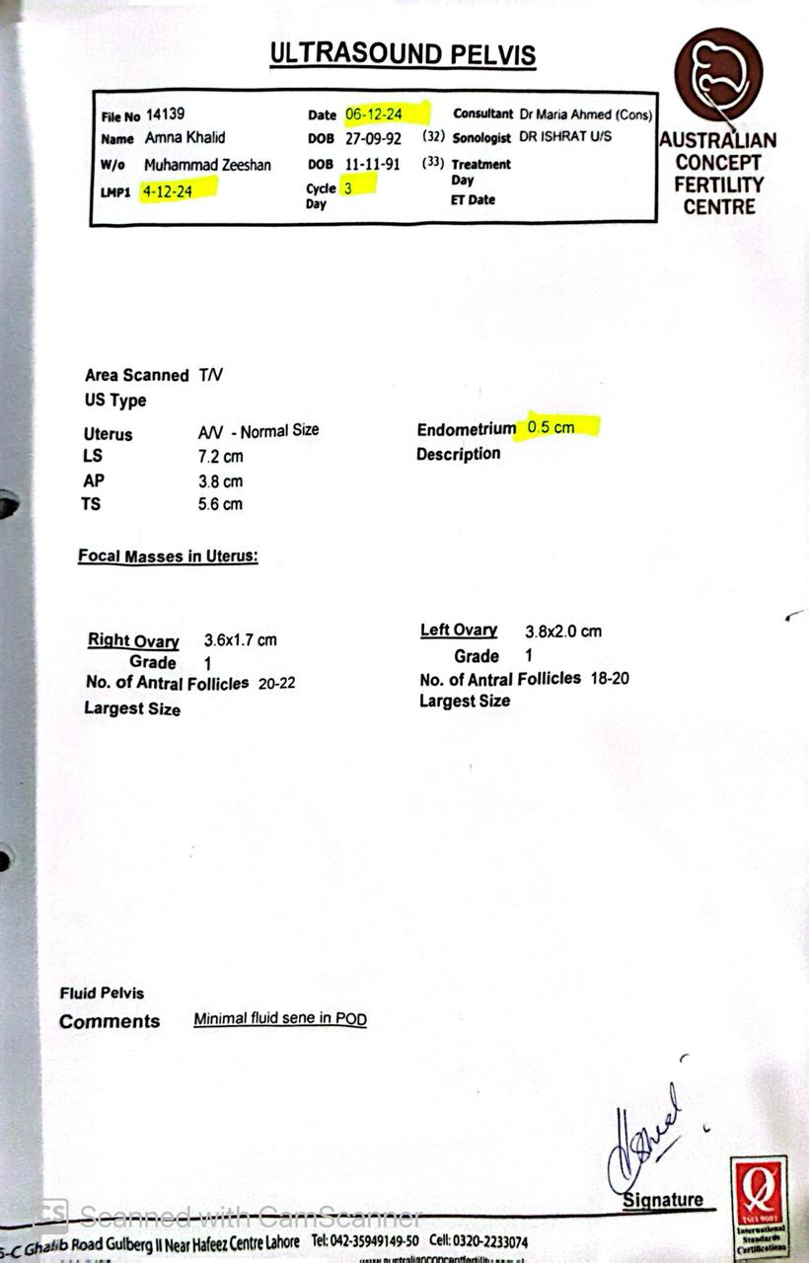

Slide 31
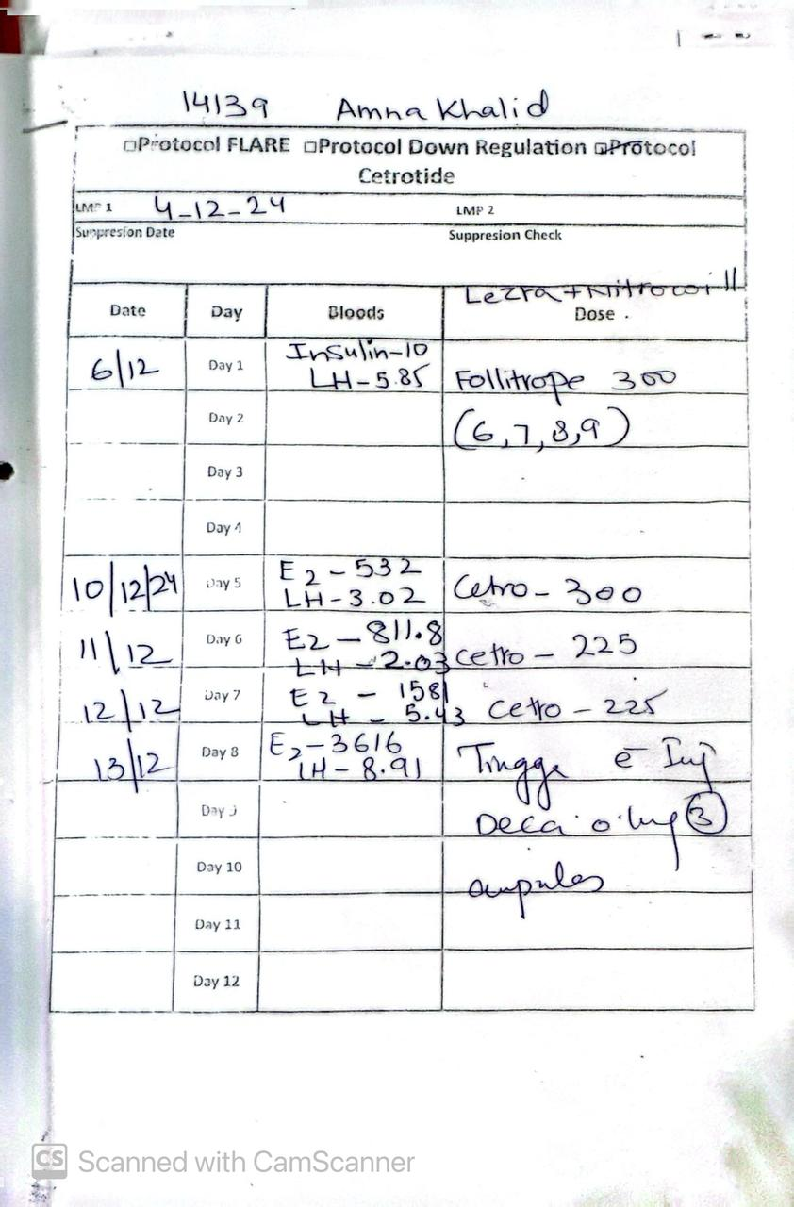

Slide 32
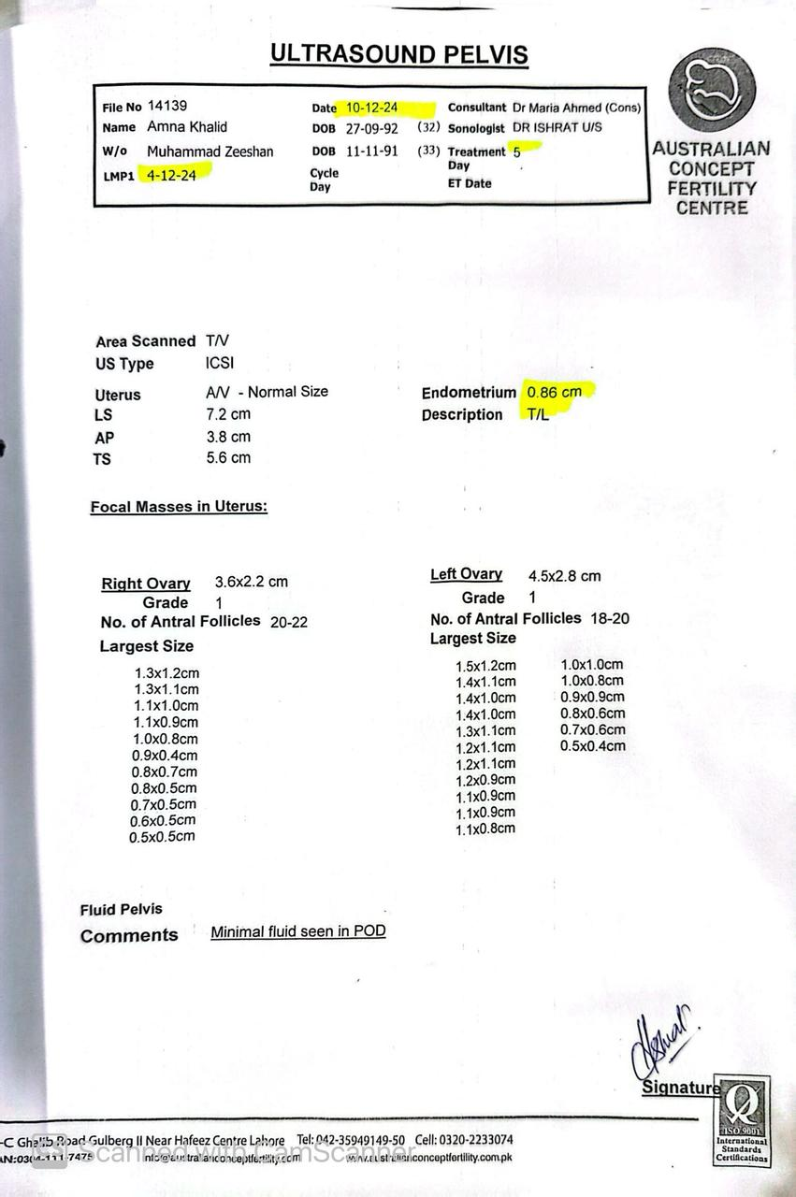

Slide 33
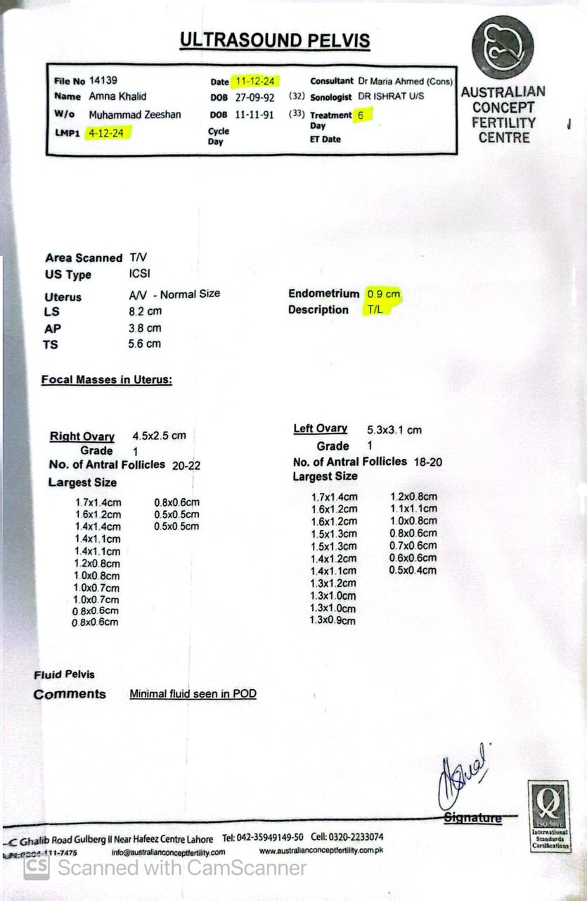

Slide 34
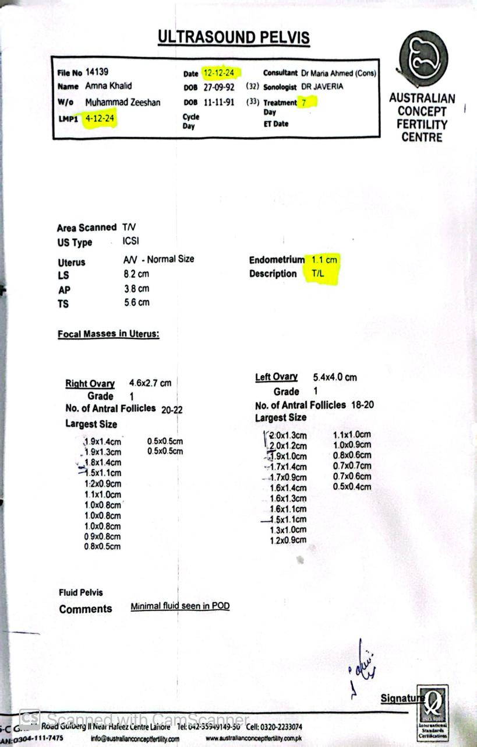

Slide 35
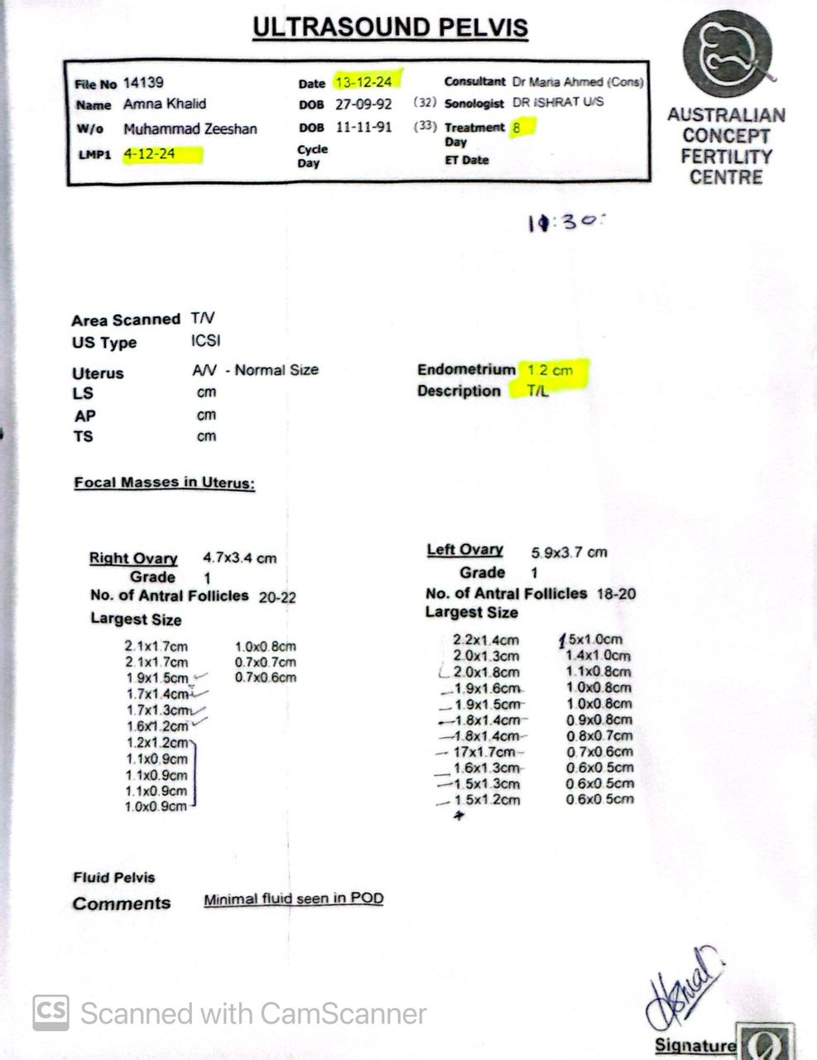

Slide 36
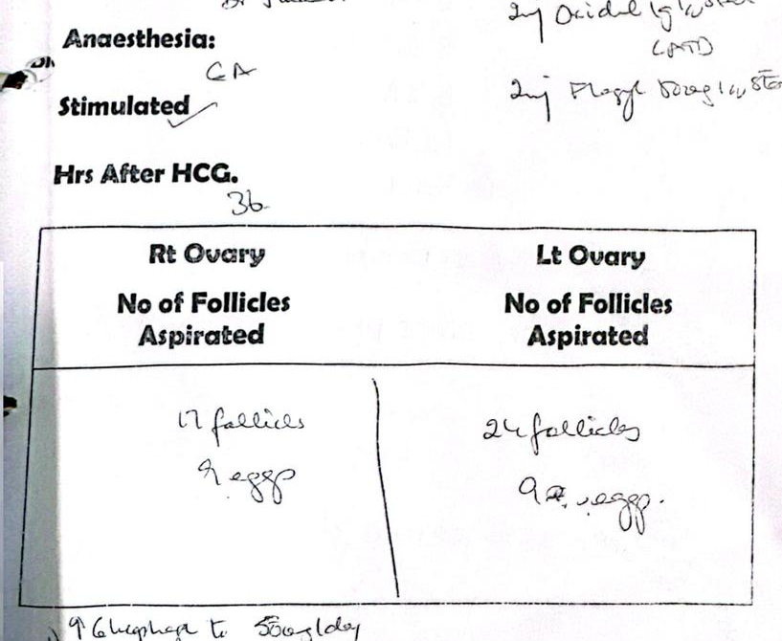

Slide 37
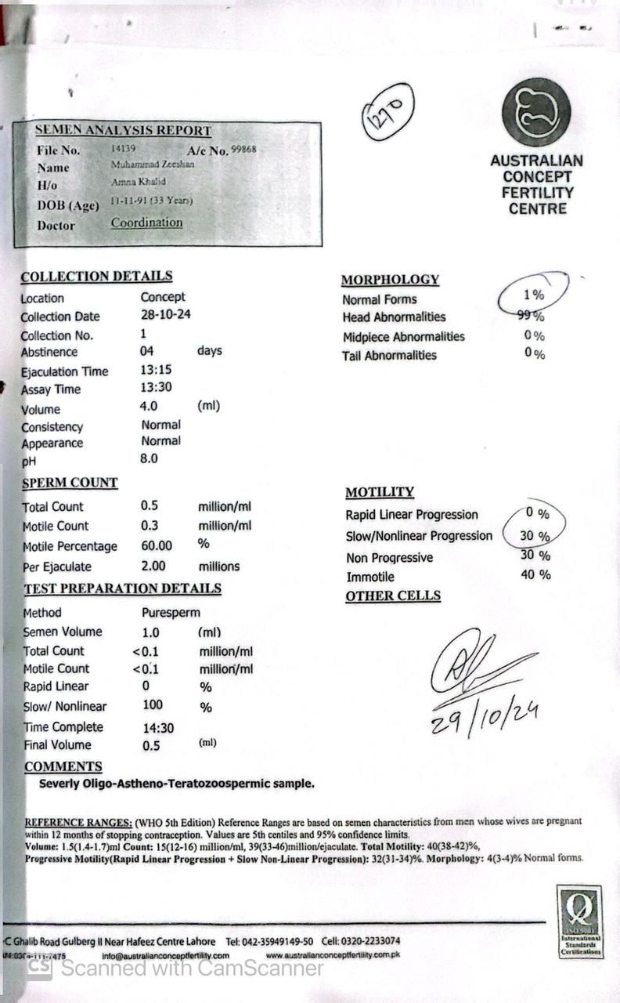

Slide 38
Take home message
Personalization of Protocol…..One Size Doesnot Fit All
Choice of protocol
Close monitoring through ultrasound and hormonal assessment is crucial
Patient safety….. Minimize the risks of OHSS and multiple pregnancy

Slide 39


